Slide 1
Symbols for Hierarchical Robot Planning
Arthur Wandzel
arthur_wandzel@brown.edu
37th Soar Workshop
June 7th 2017

Slide 2
Brown Robotics: Robotics, Learning and Autonomy
Fabulous Three
Core Objective:
Generally intelligent autonomous robots capable of solving a number of real-world tasks.
Sub-Areas:
AI-Robotics
Reinforcement Learning
Mobile Manipulation/Navigation
http://robotics.cs.brown.edu/
Stefanie Tellex
Michael Littman
George Konidaris

Slide 3
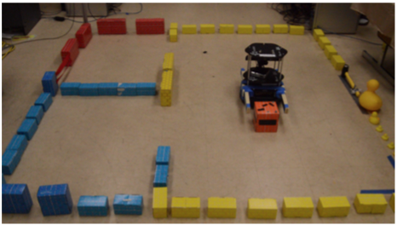
Robot Tasks
Baxter (manipulation)
Turtlebot (navigation)
Notes:
BaxterWeight 165 lbs.
Degrees of Freedom 7 per arm
Maximum Reach 1210 (5 inches) mm per armEmbedded Vision Camera in each arm

Slide 4
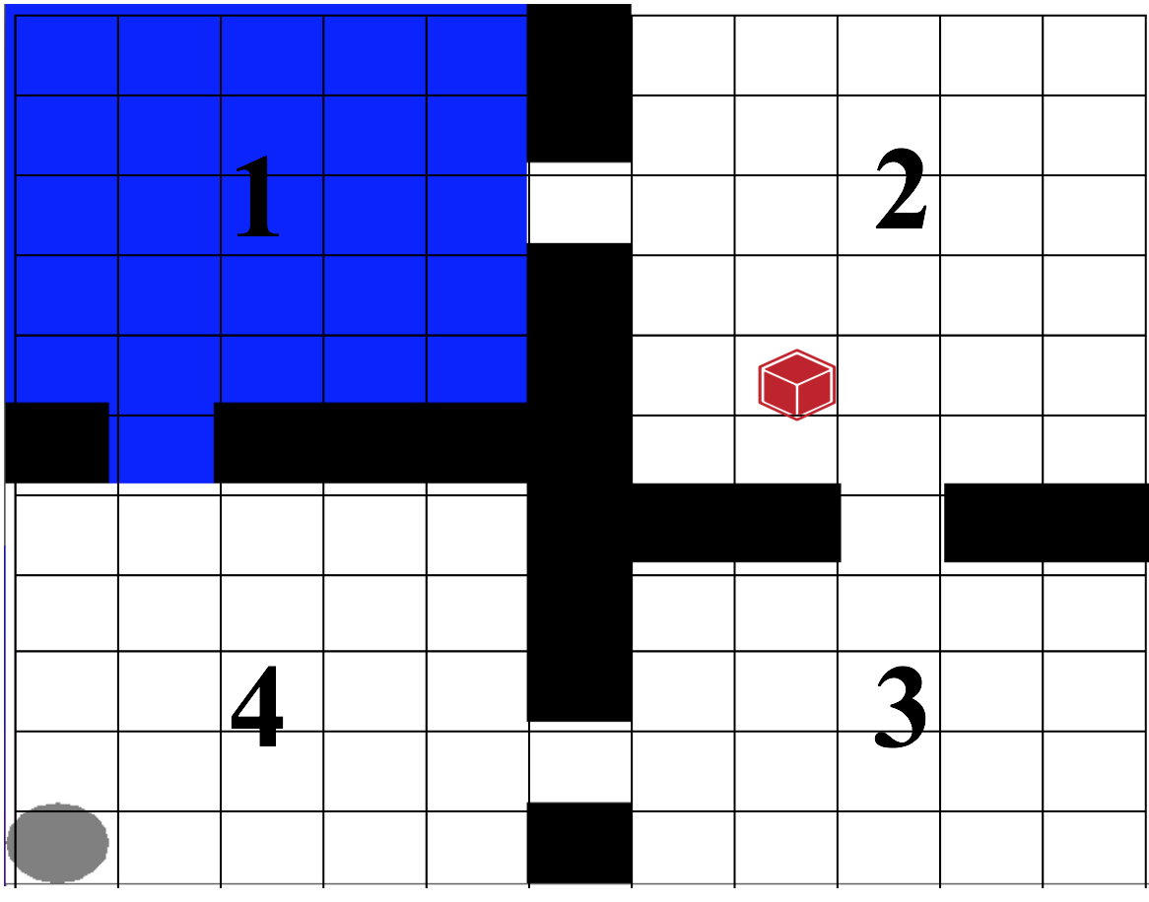
Task Representation
“Move the red block to room 1”

Slide 5
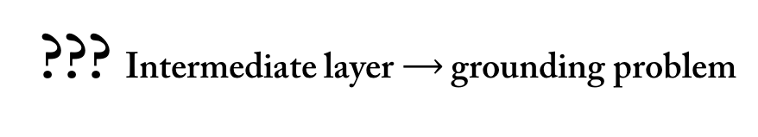
Robot Hierarchical Planning
High-Level Planning
Discrete, abstract, symbolic
(^pickUp <block>)
(^moveTo <block> <room>)
(^putDown <block>)
??? Intermediate layer $⟶$ grounding problem
Continuous, noisy, locally and partially observable, sensorimotor space
Low-Level Control

Slide 6
Task Representation
“Move the red block to room 1”
How do we start to represent the environment? Answer: hierarchical reinforcement learning.

Slide 7

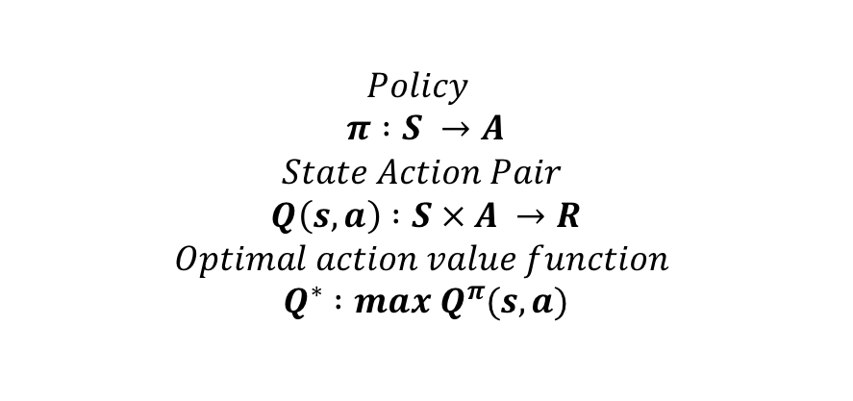
Low-Level Control
Reinforcement Learning Framework: learning to maximize reward in an environment in which an agent can take action.
π, r
$$Policy$$
$$π :S →A$$
$$State Action Pair$$
$$Q\left(s,a\right) :S × A →R$$
$$Optimal action value function$$
$$Q^{∗} :max{ Q}^{π}(s,a)$$
a

Slide 8
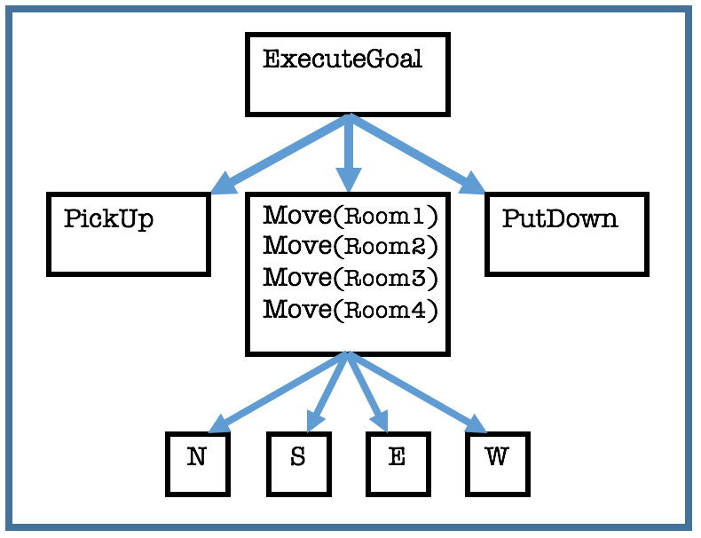
Hierarchical Reinforcement Learning
RL typically solves a single problem at the ground level (“flat solution” with action primitives).
Hierarchical RL:
Create and use high-level action abstractions
Make an abstract action represent a subproblem
Each subproblem is also an RL problem
Decompose the task specification into abstract actions (”options” in RL terms).

Slide 9
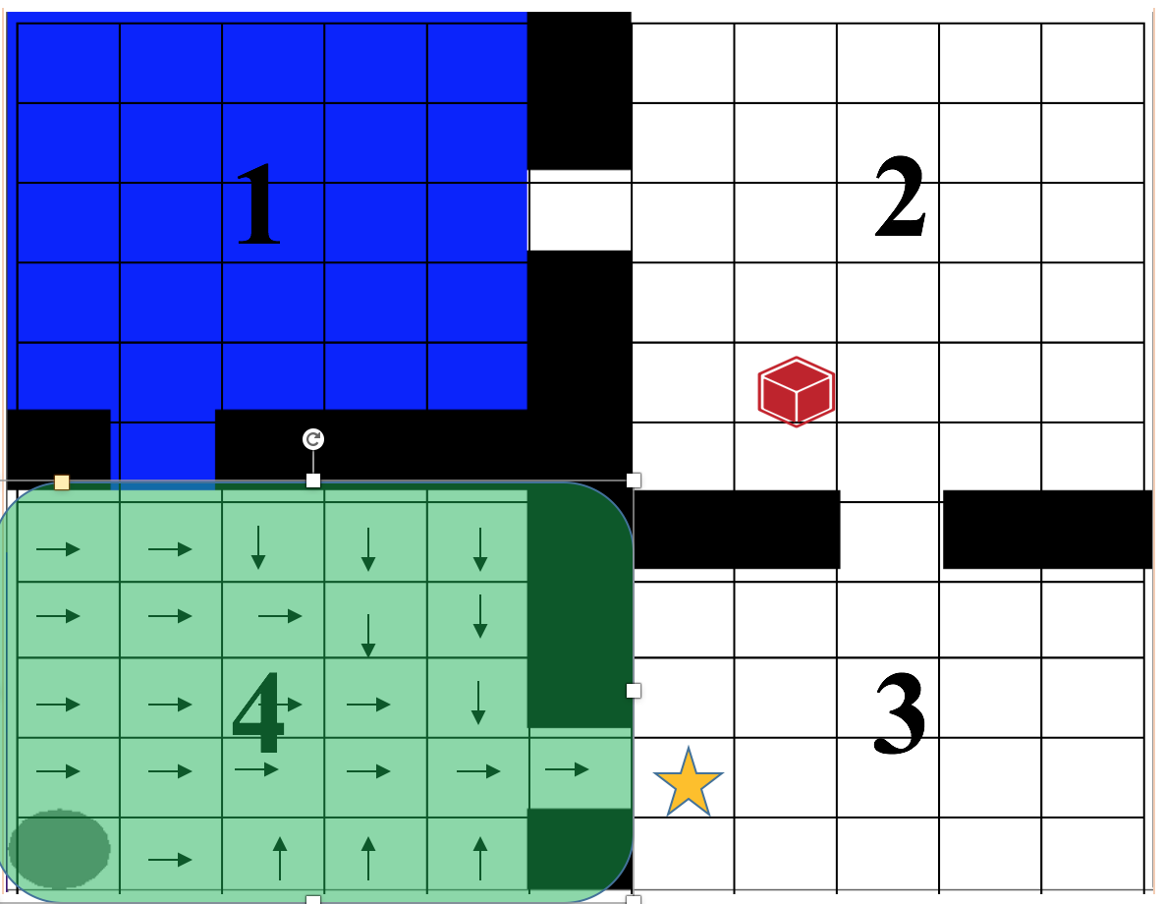
Example of Action Abstraction
Move(Room3)
Initiation set
Termination set
Policy

Slide 10
Task Representation
“Move the red block to room 1”
Action Driven
How do we start to represent the environment? Answer: hierarchical reinforcement learning.
Given our abstract actions, how do we generate a grounded plan? Answer: intermediate grounding symbols.

Slide 11
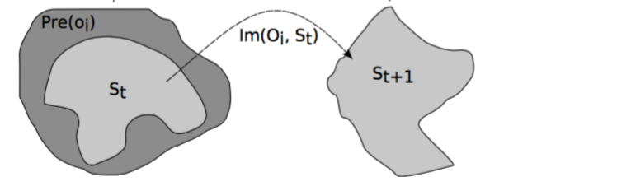
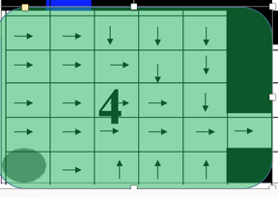
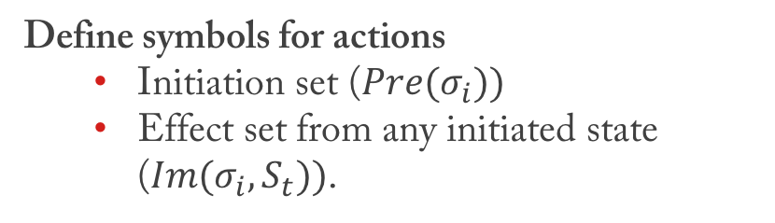
Intermediate Grounding Symbols
Abstract action $σ_{i}$: two intermediate grounding symbols
Define symbols for actions
Initiation set ($Pre(σ_{i}))$
Effect set from any initiated state ($Im(σ_{i}, S_{t}))$.

Slide 12
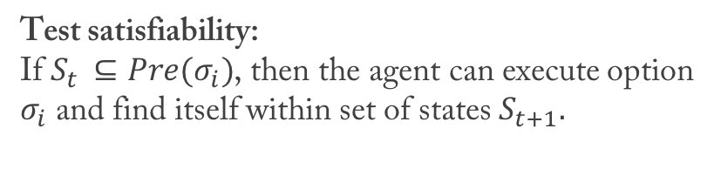
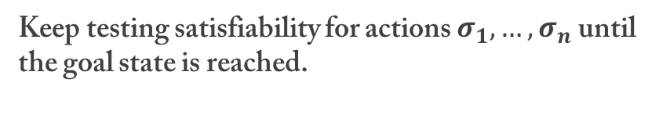
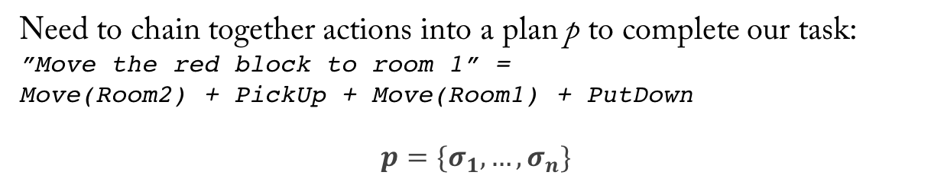
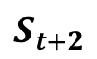
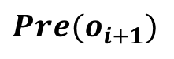
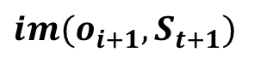
Planning with Abstract Actions
Need to chain together actions into a plan p to complete our task:
”Move the red block to room 1” =
Move(Room2) + PickUp + Move(Room1) + PutDown
$$p=\{σ_{1},…, σ_{n}\}$$
$$Pre(o_{i+1})$$
$$im(o_{i+1},S_{t+1})$$
Test satisfiability:
If $S_{t }⊆Pre(σ_{i})$, then the agent can execute option $σ_{i}$ and find itself within set of states $S_{t+1}.$
$$S_{t+2}$$
Keep testing satisfiability for actions $σ_{1},…,σ_{n}$ until the goal state is reached.

Slide 13
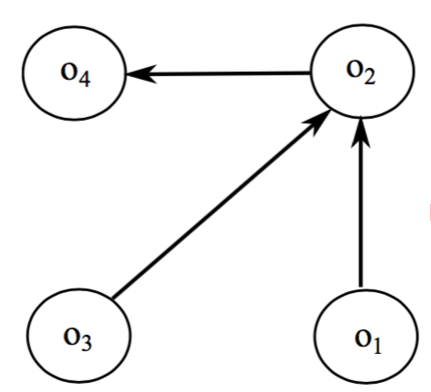
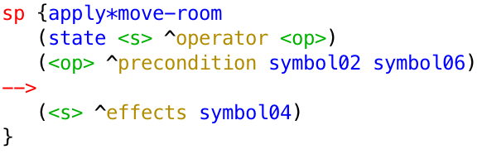
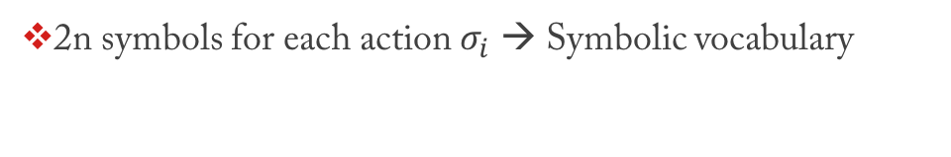
High-Level Planning
2n symbols for each action $σ_{i}$ → Symbolic vocabulary
Build a planning graph:
a graph with n nodes, and an edge from node i to node j if action i’s effect set is a subset of action j’s initiation set.
Planning can be executed as a number of production rules without groundings.

Slide 14
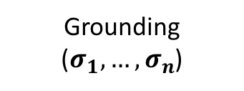
Intermediate Grounding Symbol Learning
How do you learn intermediate grounding symbols? Run the robot! Enough to define action initiation and effect sets (classification methods)
Grounding
($σ_{1},…,σ_{n}$)
Action Model
Initiation/Effect
Dynamic Updates to model Action Learning
(chunking)

Slide 15
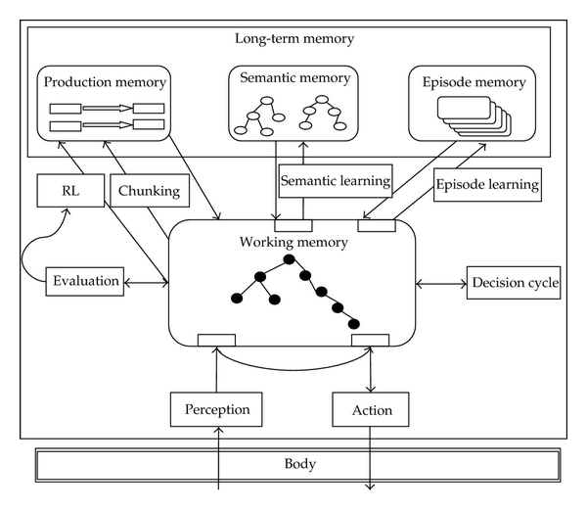
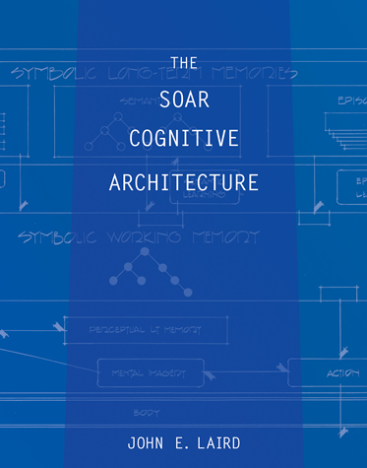
Robot Hierarchical Planning
High-Level Planning
Discrete, abstract, symbolic
(^pickUp <block>)
(^moveTo <block> <room>)
(^putDown <block>)
??? Intermediate layer $⟶$ grounding problem
Continuous, noisy, locally and partially observable, sensorimotor space
Low-Level Control

Slide 16


Nuggets and Coal
Method of constructing symbols from real world sensors and actuators.
Intermediate grounding symbols learnable (run episodes).
Soar on top?
Learning actions directly from environment (skill discovery problem).
Scaling abstract actions. Lots of grounds-keeping.

Slide 17
Contributions
Work Referenced (slides 5,7,11,12)
G.D. Konidaris. Constructing Abstraction Hierarchies Using a Skill-Symbol Loop. In Proceedings of the 25th International Joint Conference on Artificial Intelligence, pages 1648-1654, July 2016.
G.D. Konidaris, L.P. Kaelbling, and T. Lozano-Perez. Symbol Acquisition for Probabilistic High-Level Planning. In Proceedings of the Twenty Fourth International Joint Conference on Artificial Intelligence, pages 3619-3627, July 2015.
G.D. Konidaris, L. Kaelbling and T. Lozano-Perez. Constructing Symbolic Representations for High-Level Planning. In Proceedings of the Twenty-Eighth AAAI Conference on Artificial Intelligence, pages 1932-1940, July 2014.

